Slide 1
The Benefits of Using ADO.NET

Slide 2
Performance
ADO.NET increases the performance of data retrieval functions by limiting the connection time between the client and the database.

Slide 3
Scalability
Because of the minimal requirement for bandwidth, applications can be developed with less focus on minimizing the amount of data needed to be sent.

Slide 4
Interoperability
ADO.NET translates code into XML format, which is readable by most systems and applications.

Slide 5
.NET data providers have to implement the following default set of objects :
Connection
Command
DataReader
DataAdapter

Slide 6
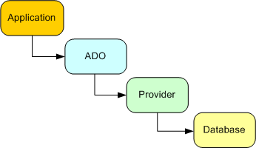
Connection String
The connection begins with the Connection String, which is placed in the app.config file. It is comprised of the server name, the database name, and login information. It’s akin to sending physical mail; the logic is the letter and the string is the address.
The information in the Connection String is sent to the provider and then connects to the database.
Example
<add connectionString="Server=<server name>; Database=<database name>; User Id=<id>; Password=<pw>;"/>

Slide 7
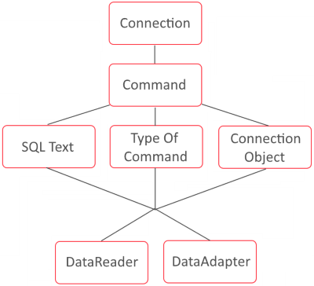
Command Object
The command object is used to execute queries in SQL.
It can take in a stored procedure, text in SQL format, or access a table directly. We then execute the command object as a SQL query by using the DataReader or DataAdapter.

Slide 8
DataReader
The DataReader retrieves data from a database. It is a forward-only method of reading data, which means it’s only going one way.
There is an IDataReader interface that all the DataReader classes implement.
The .Read() method has to be called to read any data. It can be put into a while loop where it acts as a boolean value. Whenever there’s a row to be read, it returns true.
Example
using (SqlDataReader reader = command.ExecuteReader()) { while (reader.Read()) { <code here>; } }

Slide 9
DataAdapter
DataAdapters are used to read data from a database and write the modified data to the dataset; the data is then sent back to the database.
A DataAdapter is able to ferry data between any data source and a dataset.
The SqlDataAdapter is a class in C# and acts as a bridge between the dataset and SQL Server.
Example
SqlDataAdapter adapter = new SqlDataAdapter(); adapter.SelectCommand = new SqlCommand(queryString, connection); adapter.Fill(dataset); return dataset;

Slide 10

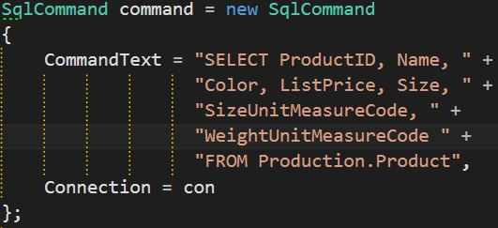
Here’s looking at you, code...

